Slide 1

The Influence of Friendships and Empathy on Rape Myth Acceptance
Katherine Seavey

Slide 2
Rape Myth Acceptance and Empathy
Rape myths: a collection of common false beliefs about sexual assault (Edwards et al., 2011; Payne et al., 1999)
Empathy: generally accepted as the ability to understand and feel the feelings of another (Preston & Hofelich, 2012)
Affective empathy: Ability to feel the emotions of another
RMA is negatively related to levels of empathy
Notes:
Examples:
Women enjoy being raped
Sexual assault is frequently falsely reported
Women who act or dress a certain way deserve to be raped
Associated with sexual aggression perpetration, bystander behavior, and social support provision to survivors
Strongest evidence supports the association between affective empathy and RMA

Slide 3
Do friendships affect RMA?
Exposure to others can influence one’s beliefs
Perceived similarity to others (Moreland & Zajonc, 1982)
Compared to men, women:
Empathize more with survivors of sexual assault (Osman, 2011; Osman, 2014)
Report lower levels of RMA (Davies et al., 2012; Johnson & Kuck, 1997)
Friendship quality is associated with empathy (Portt et al., 2020)

Slide 4
The current Project
Goal: Examine the roles of friendships and empathy in predicting RMA
H1: Female friendships and friendship intimacy will be negatively related to RMA
H2: Affective empathy will be negatively related to RMA
H3: The relation between friendships and RMA will be stronger in individuals high in affective empathy

Slide 5
Methods

Slide 6
Sample
Participant Demographics
 | M (SD )
Age | 19.127(1.685)
 | Frequency(%)
Male | 271(36.6)
African American | 74(10.0)
Asian | 212(28.6)
White | 429(57.9)
Hispanic | 73(9.9)
Native American | 4(0.5)
Other | 21(2.8)
741 university students completed the Multidimensional Inventory of Development, Sex, and Aggression (MIDSA, MIDSA clinical manual, 2011)
Brandeis (n = 631) and UMass Dartmouth (n = 110)
Data from 2012-2020
Contingency-based assessment tool
Completed for course credit
Note: Percentages for race add up to over 100% because participants were able to select multiple options for their race.

Slide 7
Measures
Information About Measures Used in Linear Models
 | Type | # Items | Scale | Calculation, Transformation | Source
RMA | Outcome | 5 | 5-point Likert-scale: definitely false” to “definitely true” | Mean | MIDSA
Female Friends | Predictor | 2 | 4-point Likert scale: “none” to “5 or more” | Sum, squared | N/A
Male Friends | Covariate | 2 | 4-point Likert scale: “none” to “5 or more” | Sum, squared | N/A
Friendship Intimacy | Predictor | 9 | 5-point Likert-scale: definitely false” to “definitely true” | Mean, squared | MIDSA
Empathy | Predictor | 8 | 5-point Likert-scale: definitely false” to “definitely true” | Mean, squared | Adapted from Interpersonal Reactivity Index (Davis, 1983)
Gender | Covariate | 1 | Male = 0 | Dummy | N/A
School | Covariate | 1 | Brandeis = 0 | Dummy | N/A
Victimization | Covariate | 9 | 6-point Likert scale: “never” to “almost every day” | Mean, negative exponent | (Espelage & Holt, 2001; Prinstein et al., 2001)

Slide 8
Measures: Outcome
RMA: Created for the MIDSA (MIDSA clinical manual, 2011). Originally 8 items, excluded 3 items not pertaining to rape myths
Five-point Likert-scale: “0 = definitely false” to “4 = definitely true”
Example item: “If a female does not strongly resist sexual advances, it means she is willing to have sex”
Notes:
RMA: “0 = definitely false” to “4 = definitely true.”
Excluded: A man must be boss in rel with woman
Friendships 0 = none to 3 = 5 or more
Intimacy: “0 = definitely false” to “4 = definitely true.”
Empathy: “0 = definitely false” to “4 = definitely true.”
Victimization: “0 = never” to “5 = almost every day.”

Slide 9
Measures: Friendships
# close and casual friendships with men and women: Sum of 2 items assessing how many close or casual friendships participants had with men or women
Four-point Likert scale: “0 = none” to “3 = 5 or more”
Male friendships included as control variable
Square transformed
Friendship intimacy: 9 items assessing the intimacy of participants’ friendships during adolescence developed for the MIDSA (MIDSA clinical manual, 2011)
Five-point Likert scale: “0 = definitely false” to “4 = definitely true”
Square transformed
Example item: “When something nice happens to me I share the experiences with my friend.”
Notes:
Friendships 0 = none to 3 = 5 or more
Intimacy: “0 = definitely false” to “4 = definitely true.”
Empathy: “0 = definitely false” to “4 = definitely true.”
Victimization: “0 = never” to “5 = almost every day.”

Slide 10
Measures: Empathy
Empathy: Measure of affective empathy, eight items adapted from the Interpersonal Reactivity Index (Davis, 1983)
Five-point Likert scale: “0 = definitely false” to “4 = definitely true”
Example item: “When I see someone treated unfairly, I feel sorry.”
Notes:
RMA: “0 = definitely false” to “4 = definitely true.”
Excluded: A man must be boss in rel with woman
Friendships 0 = none to 3 = 5 or more
Intimacy: “0 = definitely false” to “4 = definitely true.”
Empathy: “0 = definitely false” to “4 = definitely true.”
Victimization: “0 = never” to “5 = almost every day.”

Slide 11
Measures: Covariates
Gender: Covariate, dichotomous
Male = 0
School: Covariate, dichotomous
Brandeis = 0
Victimization: Covariate, 9 items assessing sexual harassment victimization adapted from measures used in past research (Espelage & Holt, 2001; Prinstein et al., 2001)
Covers a wide range of experiences including being leered at, touched sexually, and made to feel like they would pay for rejecting someone
Negative exponentially transformed
Six-point Likert scale: “0 = never” to “5 = almost every day”
Notes:
RMA: “0 = definitely false” to “4 = definitely true.”
Excluded: A man must be boss in rel with woman
Friendships 0 = none to 3 = 5 or more
Intimacy: “0 = definitely false” to “4 = definitely true.”
Empathy: “0 = definitely false” to “4 = definitely true.”
Victimization: “0 = never” to “5 = almost every day.”

Slide 12
Analytical Plan
Hierarchical regression
Step 1: Covariates (gender and victimization)
Step 2: Add friendships
Step 3: Add empathy
Step 4: Check interaction between empathy and friendships
Bayesian Modeling
MCMC using rstanarm with default priors
Diagnostics: n^{eff} ratio and r-hat, trace plots, density overlay plots, autocorrelation plots
Model comparison: Bayes r-squared, posterior predictive check, ELPD comparison
Assessment of hypotheses: coefficient estimates and credible intervals, probability of direction
Notes:
Used default priors because the measures were primarily customized for the MIDSA

Slide 13
Results

Slide 14
Descriptive Information
Reliability and Descriptive Statistics for Untransformed Scales
 | # items | α | Mean | SD
RMA | 5 | 0.73 | 1.33 | 0.52
Empathy | 8 | 0.67 | 2.61 | 0.60
Friendship intimacy | 9 | 0.77 | 3.38 | 0.50
Victimization | 9 | 0.68 | 1.44 | 0.46

Slide 15
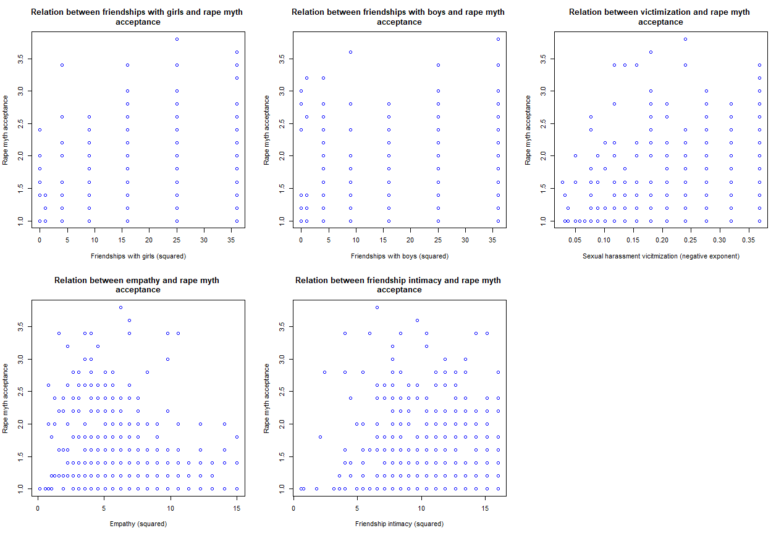

Slide 16
Priors
Prior Information for Each Term in Subsequent Models
 | Model 1 | Model 2 | Model 3 | Model 4
Intercept | Normal(1.30, 1.30) | Normal(1.33, 1.31) | Normal(1.33, 1.31) | Normal(1.33, 1.31)
Gender | Normal(0, 2.71) | Normal(0, 2.71) | Normal(0, 2.71) | Normal(0, 2.71)
Victimization | Normal(0, 14.39) | Normal(0, 14.40) | Normal(0, 14.40) | Normal(0, 14.40)
School | Normal(0, 3.67) | Normal(0, 3.67) | Normal(0, 3.67) | Normal(0, 3.67)
Male Friendships | - | Normal(0, 0.12) | - | -
Female Friendships | - | Normal(0, 0.13) | - | -
Friendship Intimacy | - | Normal(0, 0.42) | Normal(0, 0.42) | Normal(0, 0.42)
Empathy | - | - | Normal(0, 0.43) | Normal(0, 0.43)
Empathy*FI | - | - | - | Normal(0, 0.03)
Sigma | Exponential(1.9) | Exponential(0.52) | Exponential(0.52) | Exponential(0.52)
Notes:
R seems to automatically center the predictors

Slide 17
Diagnostics: N^{eff} and r-hat
Diagnostic Information for Each Term for Subsequent Models(N^{eff}, R-hat)
 | Model 1 | Model 2 | Model 3 | Model 4
Intercept | 1.21, 1.00 | 1.24, 1.00 | 1.38, 1.00 | 0.59, 1.00
Gender | 1.20, 1.00 | 0.83, 1.00 | 1.13, 1.00 | 0.99, 1.00
Victimization | 1.32, 1.00 | 1.14, 1.00 | 1.22, 1.00 | 1.00, 1.00
School | 1.25, 1.00 | 1.08, 1.00 | 1.22, 1.00 | 0.99, 1.00
Male Friendships | - | 0.91, 1.00 | - | -
Female Friendships | - | 1.02, 1.00 | - | -
Friendship Intimacy | - | 1.13, 1.00 | 1.34, 1.00 | 0.54, 1.00
Empathy | - | - | 1.28, 1.00 | 0.52, 1.00
Empathy*FI | - | - | - | 0.51, 1.00
Sigma | 1.37, 1.00 | 1.19, 1.00 | 1.41, 1.00 | 1.03, 1.00

Slide 18
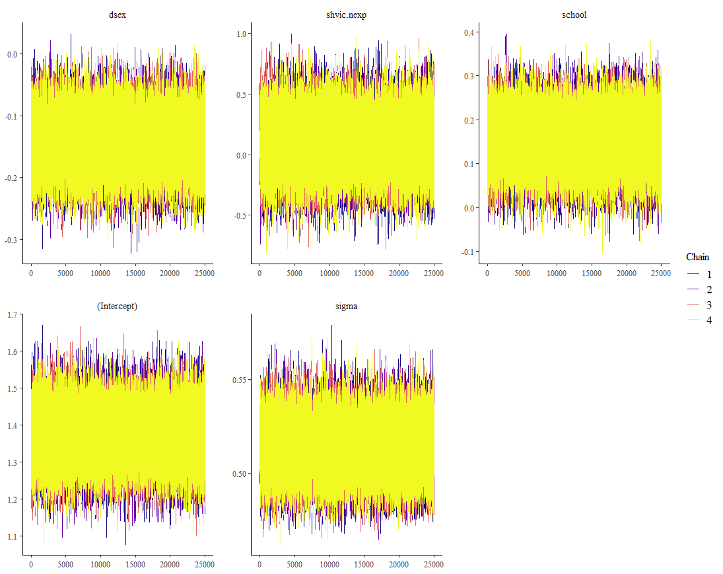
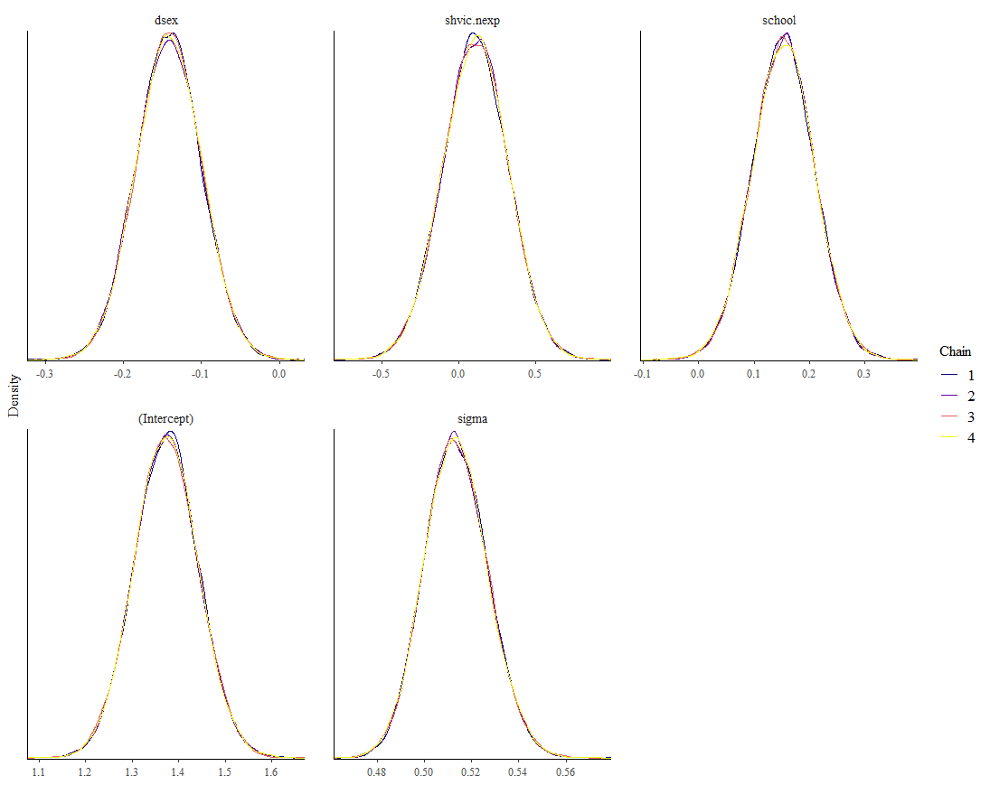
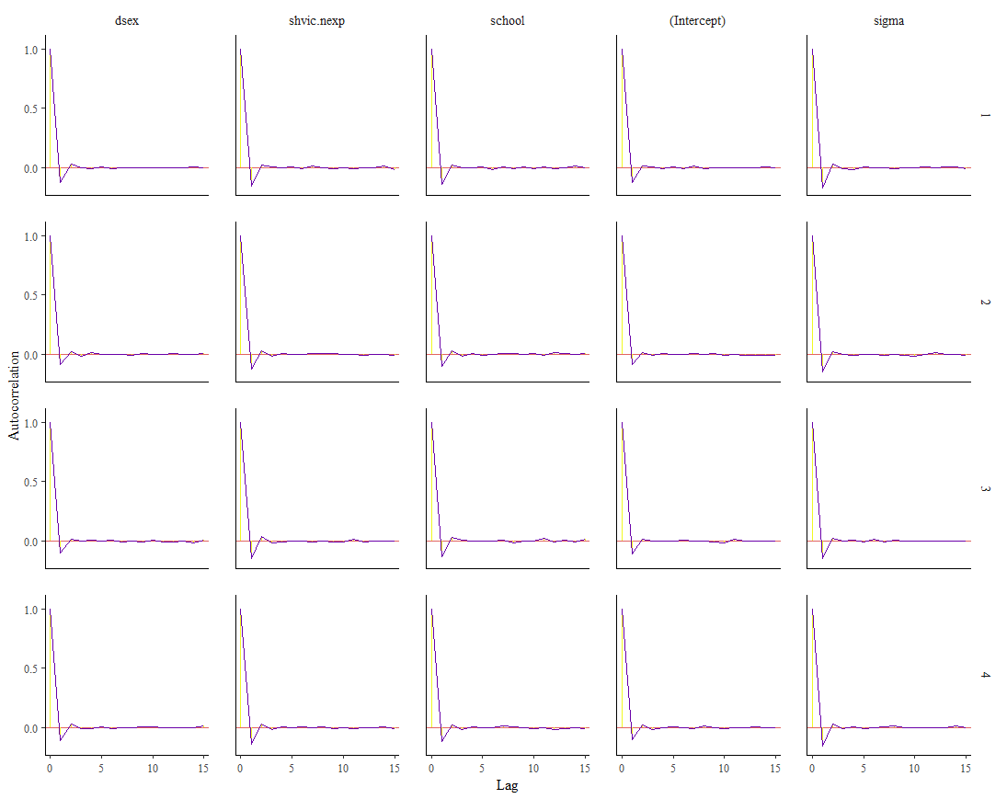
Diagnostic Plots: Model 1

Slide 19
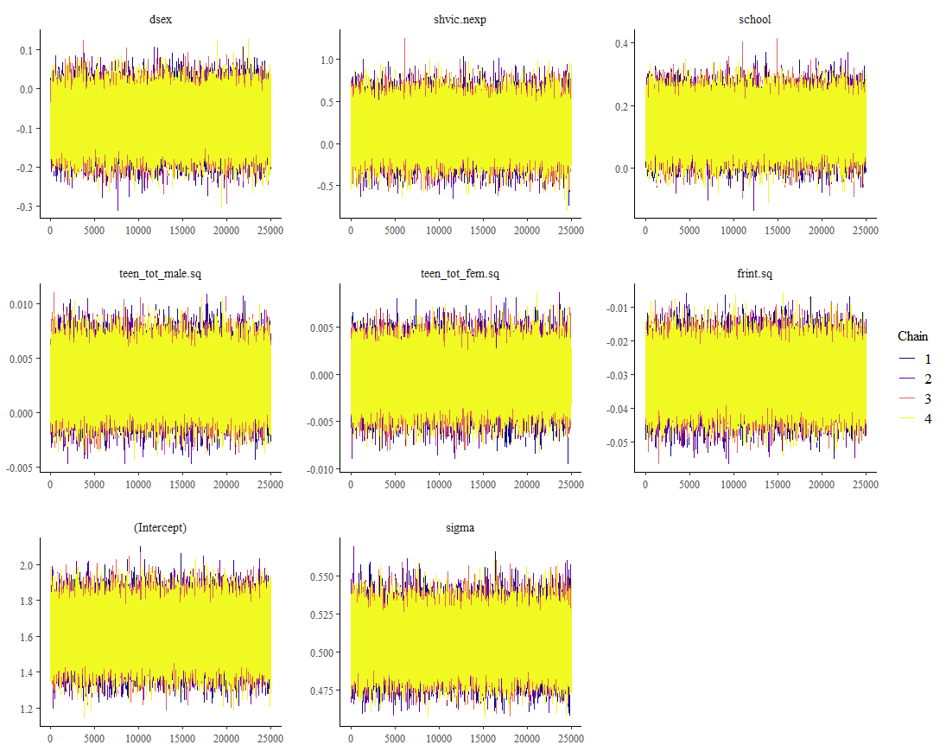
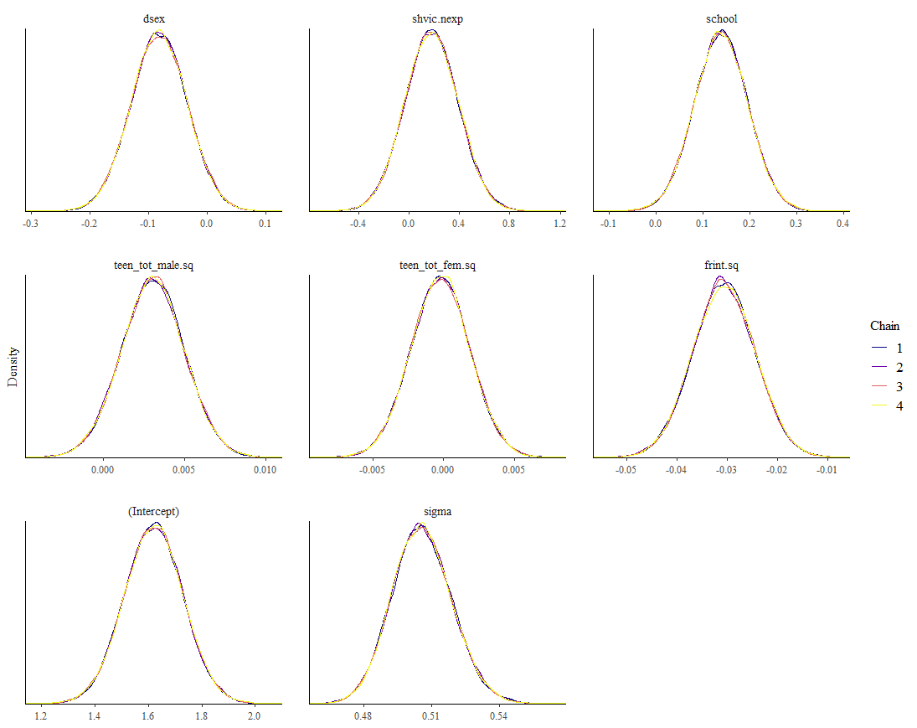
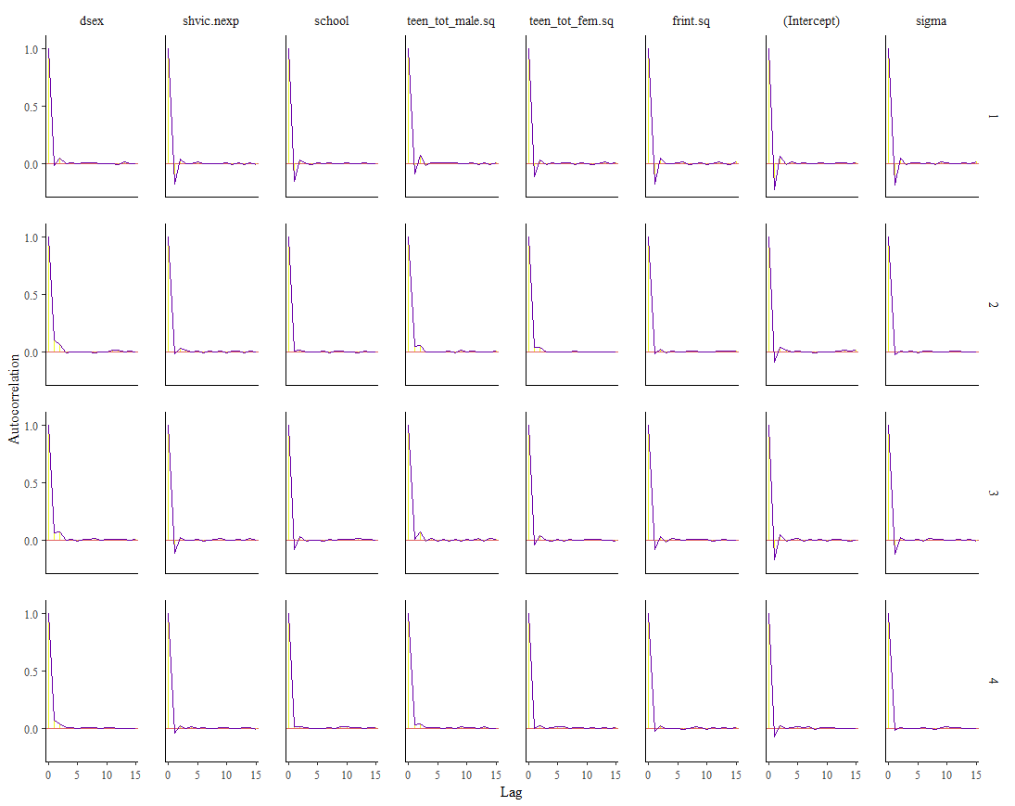
Diagnostic Plots: Model 2

Slide 20
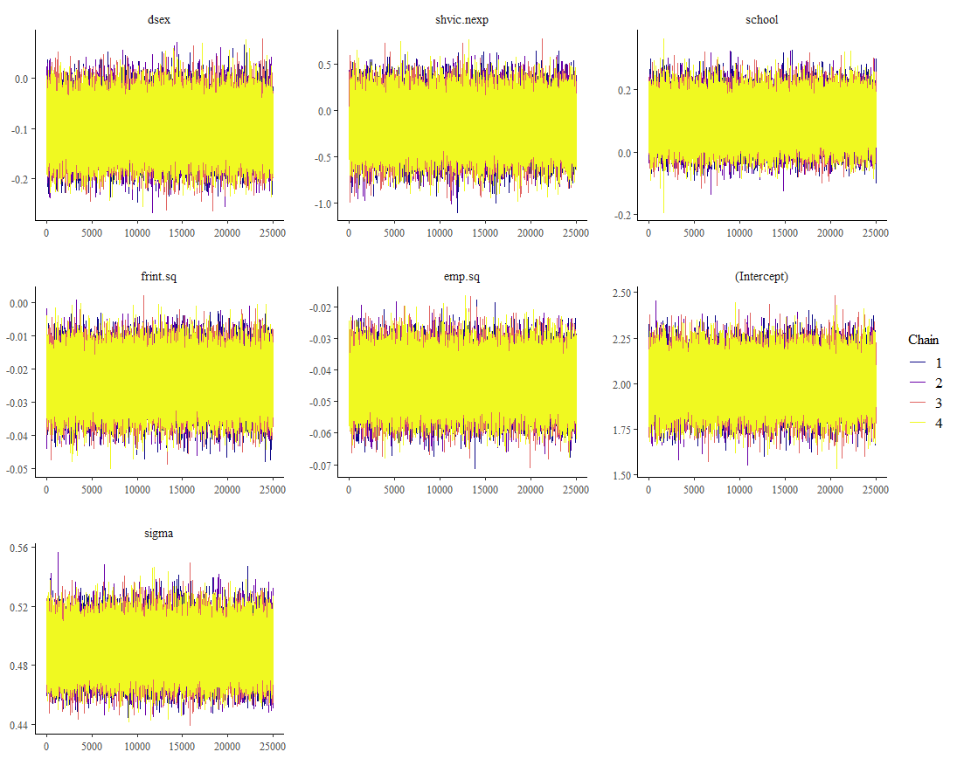
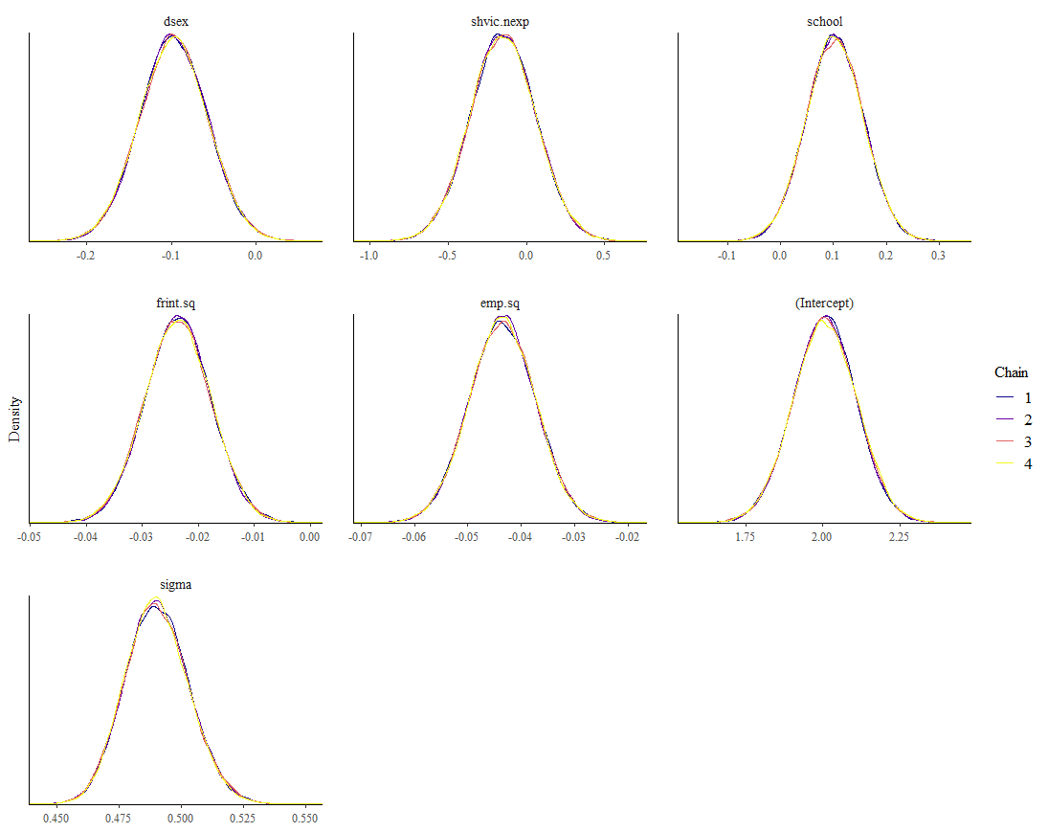
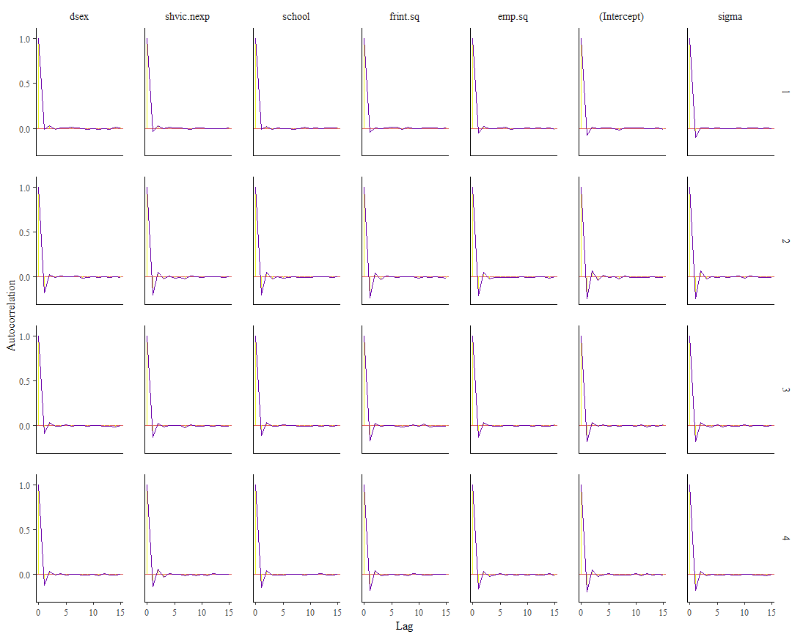
Diagnostic Plots: Model 3

Slide 21
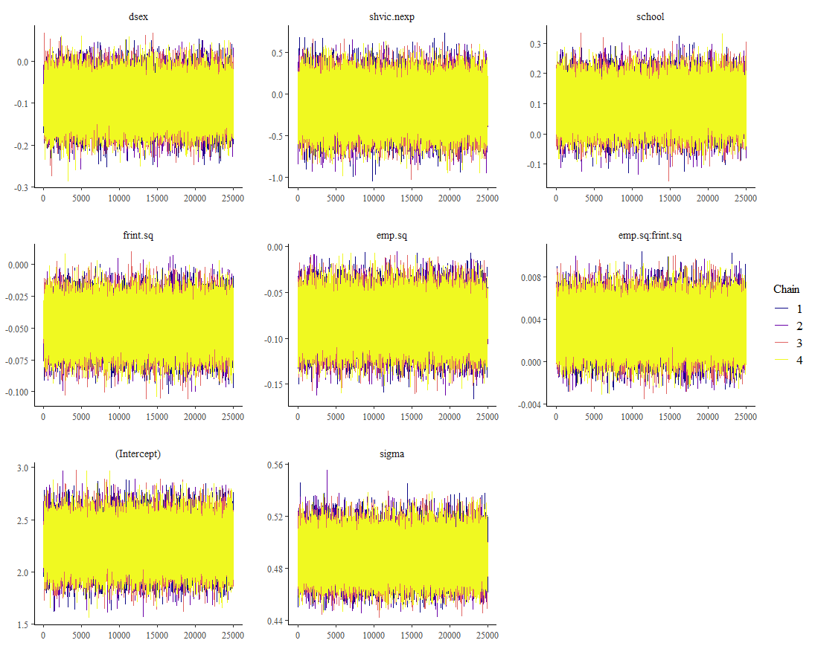
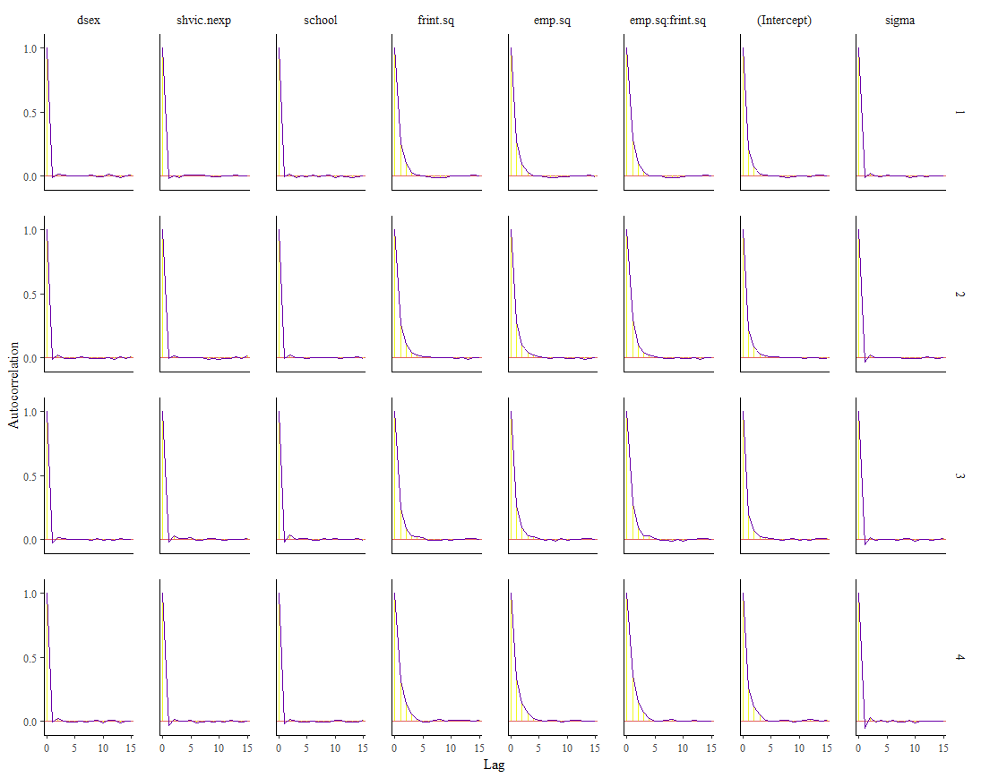
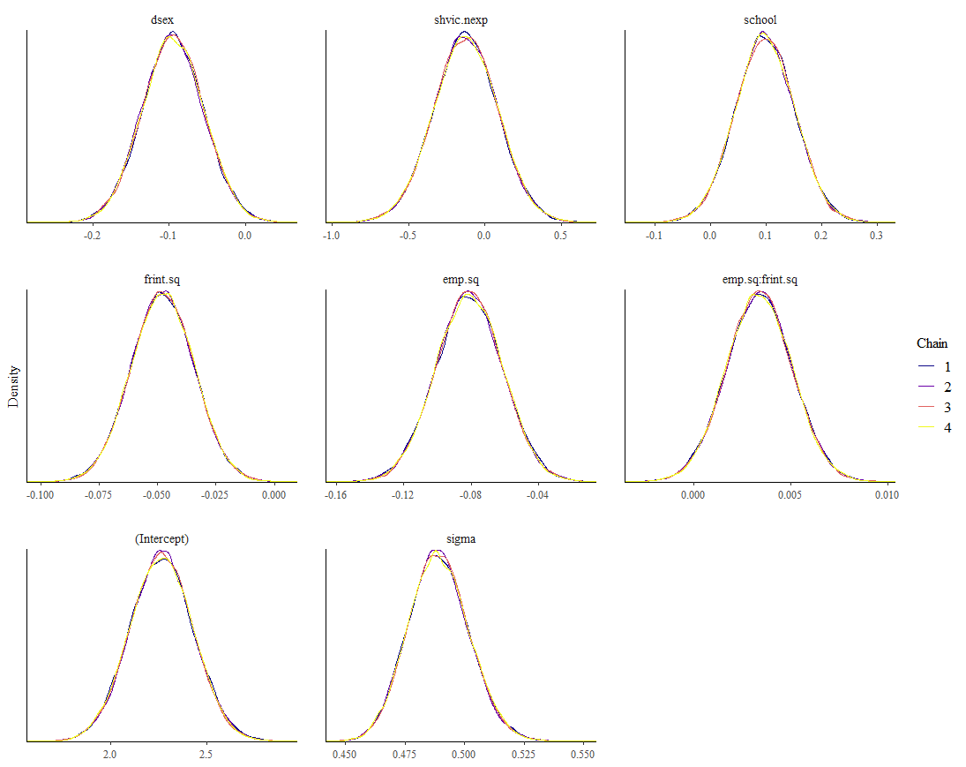
Diagnostic Plots: Model 4

Slide 22
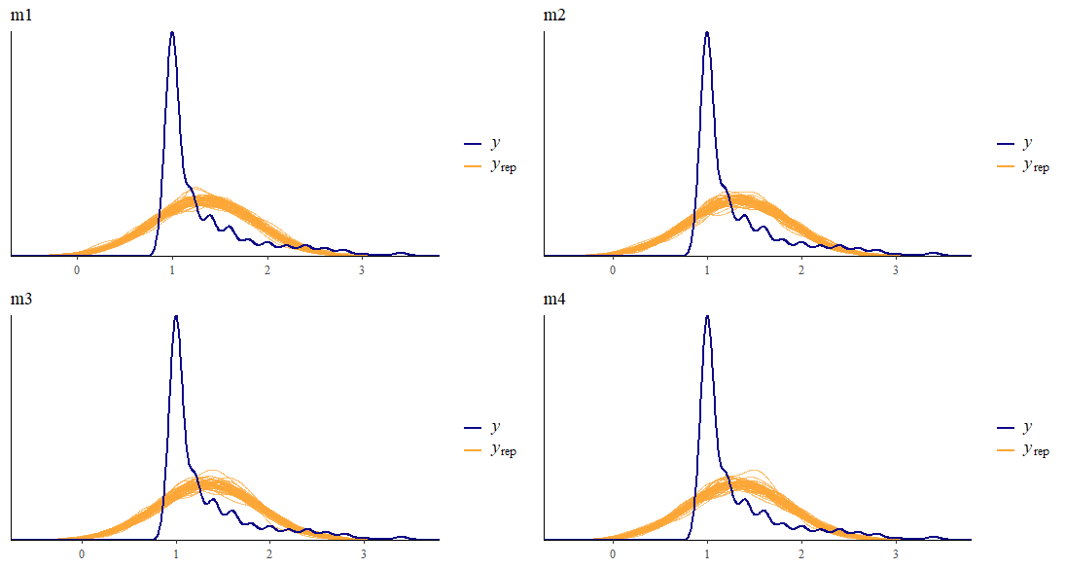
Posterior predictive Check

Slide 23
Model Comparison: estimates
Parameter Estimates and 95% Credible Intervals for Each Term in Subsequent Models (Median, HDI)
 | Model 1 | Model 2 | Model 3 | Model 4
Gender | -0.14(-0.22, -0.05) | -0.08(-0.18, 0.01) | -0.10(-0.18, -0.02) | -0.10(-0.17, -0.02)
Victimization | 0.11(-0.31, 0.53) | 0.18(-0.24, 0.59) | -0.15(-2*10⁻³, 0.21) | -0.13(-0.55, 0.28)
School | 0.15(0.05, 0.27) | 0.14(0.03, 0.25) | 0.10(-2*10⁻³, 0.21) | 0.10(-0.01, 0.20)
Male Friendships | - | 3*10⁻³(-7*10⁻⁴, 7*10⁻³) | - | -
Female Friendships | - | -2*10⁻⁴ (-4*10⁻³, 4*10⁻³) | - | -
Friendship Intimacy | - | -0.03(-0.04, -0.02) | -0.02(-0.04, -0.01) | -0.05(-0.07, -0.02)
Empathy | - | - | -0.04(-0.06, -0.03) | -0.10(-0.12, -0.04)
Empathy*FI | - | - | - | 3*10⁻³(8*10⁻⁵, 6*10⁻³)
Notes:
Note the removal of male and female friendships

Slide 24
Model Comparison: Bayes R²
Bayes R² Statistics for Each Model
 | Median | Mean | SD | 5% CI | 95% CI
M1 | 0.04 | 0.04 | 0.01 | 0.02 | 0.07
M2 | 0.08 | 0.08 | 0.02 | 0.05 | 0.11
M3 | 0.13 | 0.13 | 0.02 | 0.10 | 0.17
M4 | 0.14 | 0.14 | 0.02 | 0.10 | 0.18

Slide 25
Cross Validation and ELPD Comparison
Cross Validation Results for Each Model
 | MAE | MAE Scaled | Within 50 | Within 95
M1 | 0.26 | 0.51 | 0.66 | 0.93
M2 | 0.27 | 0.53 | 0.63 | 0.93
M3 | 0.27 | 0.55 | 0.61 | 0.94
M4 | 0.26 | 0.52 | 0.65 | 0.94
ELPD Comparisons for Each Model
 | Difference in ELPD | SE of the difference
M4 | 0.0 | 0.0
M3 | -0.8 | 2.3
M2 | -24.5 | 7.6
M1 | -10.9 | 9.4

Slide 26
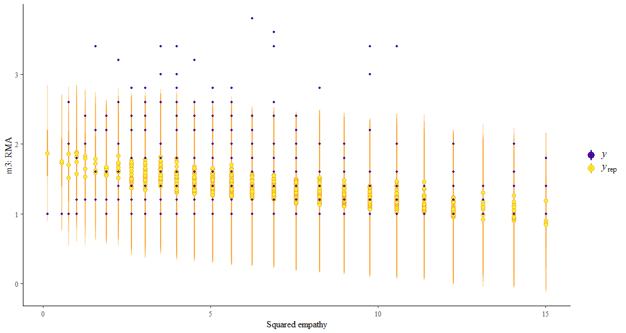
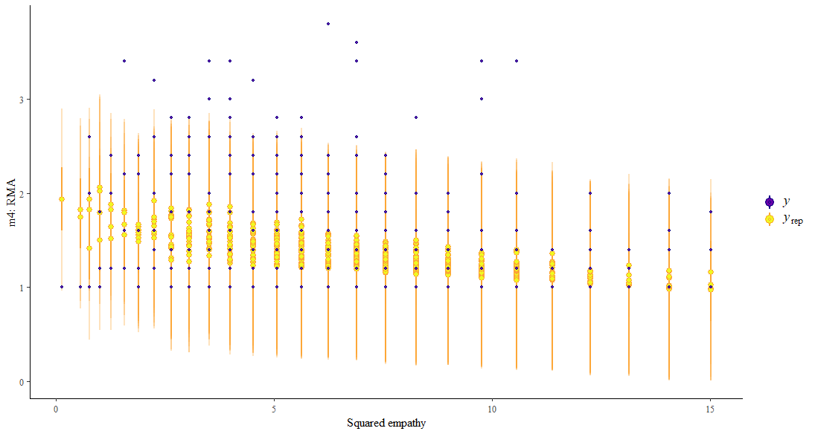
Predictive Intervals
Visualized Predictive Intervals and Corresponding Data for the Association between Empathy and RMA in M3 and M4

Slide 27
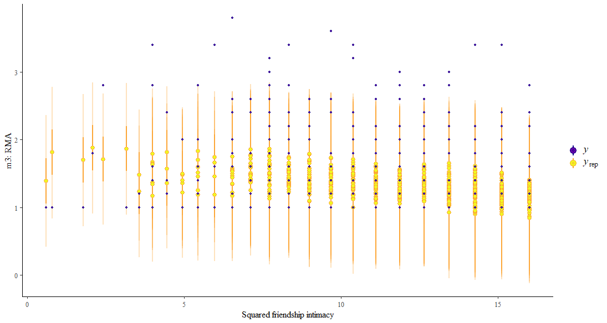
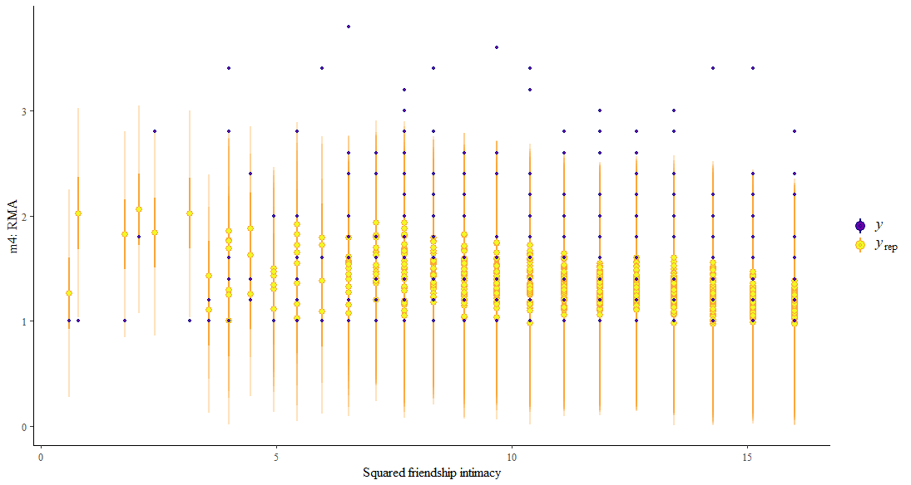
Predictive Intervals
Visualized Predictive Intervals and Corresponding Data for the Association between Friendship Intimacy and RMA in M3 and M4

Slide 28
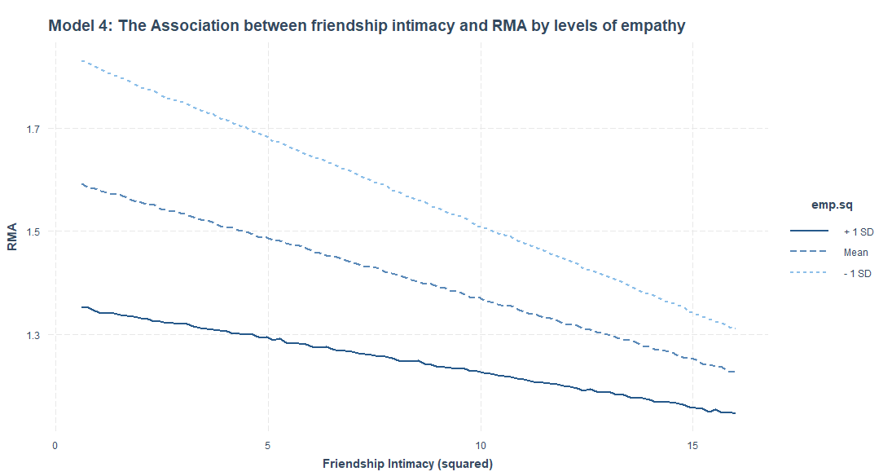
Is the Interaction Term Useful?

Slide 29
Final Model: Results
Parameter Estimates and Probability of Direction Estimates for Model 3
 | Intercept | Gender | Victimization | School | Friendship Intimacy | Empathy | Sigma
Median | 2.00 | -0.10 | -0.15 | 0.10 | -0.02 | -0.04 | 0.49
95% HDI | 1.81, 2.21 | -0.18, -0.02 | -0.56, 0.26 | 0.00, 0.21 | -0.04, -0.01 | -0.06, -0.03 | 0.47, 0.52
Probability of Direction | 1.00 | 0.99 | 0.76 | 0.97 | 1.00 | 1.00 | 1.00
Bayes Factors for Different Nulls for Friendship Intimacy and Empathy in Model 3
 | Null = 0 | 0 > Null > Infinity
Friendship Intimacy | 23.62 | 1.22*10⁴
Empathy | 1.41*10⁵ | 7.04*10⁷
Notes:
Jeffreys (1961) ("jeffreys1961"; default)
BF = 1 - No evidence
1 < BF <= 3 - Anecdotal
3 < BF <= 10 - Moderate
**10 < BF <= 30 - Strong**
30 < BF <= 100 - Very strong
**BF > 100 - Extreme.**
Raftery (1995) ("raftery1995")
BF = 1 - No evidence
1 < BF <= 3 - Weak
3 < BF <= 20 - Positive
**20 < BF <= 150 - Strong**
**BF > 150 - Very strong**

Slide 30
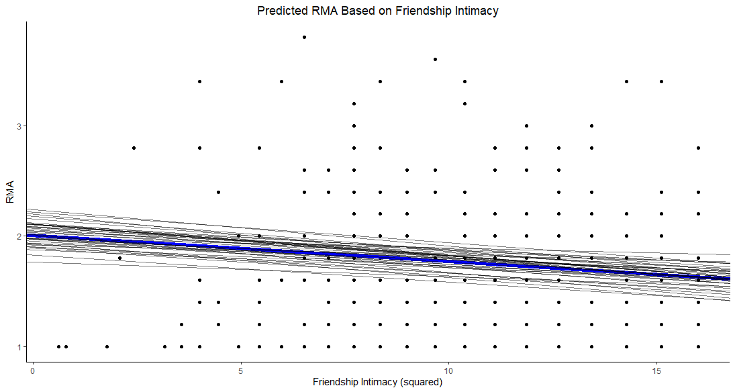

Slide 31
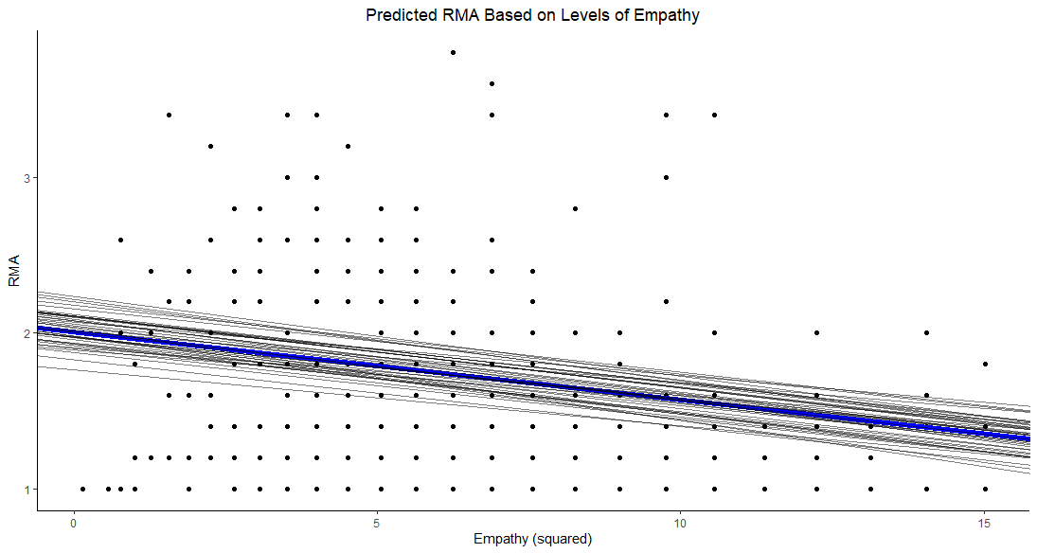

Slide 32
Conclusions

Slide 33
Conclusions
Friendships and empathy appear to influence RMA
These associations are both highly likely to be negative
The evidence for a model including an interaction is mixed
I do not believe the evidence is strong enough to support an interaction

Slide 34
Acknowledgements
Dr. Ray Knight
The Knight Lab
Dr. Jennifer Gutsell

Slide 35
References
Davies, M., Gilston, J., & Rogers, P. (2012). Examining the relationship between male rape myth acceptance, female rape myth acceptance, victim blame, homophobia, gender roles, and ambivalent sexism. Journal of Interpersonal Violence, 27(14), 2807–2823. https://doi.org/10.1177/0886260512438281
Davis, M. H. (1983). Measuring individual differences in empathy: Evidence for a multidimensional approach. Journal of Personality and Social Psychology, 44(1), 113–126. https://doi.org/10.1037/0022-3514.44.1.113
Edwards, K. M., Turchik, J. A., Dardis, C. M., Reynolds, N., & Gidycz, C. A. (2011). Rape myths: History, individual and institutional-level presence, and implications for change. Sex Roles, 65(11–12), 761–773. http://dx.doi.org/10.1007/s11199-011-9943-2
Espelage, D. L., & Holt, M. K. (2001). Bullying and victimization during early adolescence: Peer influences and psychosocial correlates. Journal of Emotional Abuse, 2(2/3), 123–142. https://doi.org/10.1300/J135v02n02_08
Johnson, B. E., & Kuck, D. L. (1997). Rape myth acceptance and sociodemographic characteristics: A multidimensional analysis. Sex Roles, 36(11–12), 693–707. https://doi.org/10.1023/A:1025671021697
MIDSA clinical manual. (2011). Augur Enterprises, Inc. www.midsa.us
Moreland, R. L., & Zajonc, R. B. (1982). Exposure effects in person perception: Familiarity, similarity, and attraction. Journal of Experimental Social Psychology, 18(5), 395–415. https://doi.org/10.1016/0022-1031(82)90062-2
Osman, S. (2011). Predicting rape empathy based on victim, perpetrator, and participant gender, and history of sexual aggression. Sex Roles, 64(7–8), 506–515. https://doi.org/10.1007/s11199-010-9919-7
Osman, S. L. (2014). Participant sexual victimization by an acquaintance and gender predicting empathy with an acquaintance or stranger rape victim. Journal of Social and Clinical Psychology, 33(8), 732–742. http://dx.doi.org/10.1521/jscp.2014.33.8.732
Payne, D. L., Lonsway, K. A., & Fitzgerald, L. F. (1999). Rape myth acceptance: Exploration of its structure and its measurement using the Illinois Rape Myth Acceptance Scale. Journal of Research in Personality, 33(1), 27–68. https://doi.org/10.1006/jrpe.1998.2238
Portt, E., Person, S., Person, B., Rawana, E., & Brownlee, K. (2020). Empathy and Positive Aspects of Adolescent Peer Relationships: A Scoping Review. Journal of Child & Family Studies, 29(9), 2416–2433. https://doi.org/10.1007/s10826-020-01753-x
Prinstein, M. J., Boergers, J., & Vernberg, E. M. (2001). Overt and relational aggression in adolescents: Social-psychological adjustment of aggressors and victims. Journal of Clinical Child & Adolescent Psychology, 30(4), 479–491. https://doi.org/10.1207/S15374424JCCP3004_05
Preston, S. D., & Hofelich, A. J. (2012). The many faces of empathy: Parsing empathic phenomena through a proximate, dynamic-systems view of representing the other in the self. Emotion Review, 4(1), 24–33. https://doi.org/10.1177/1754073911421378Rich, K., Seffrin, P. M., & McNichols, E. (2021). College students’ responses to their sexually assaulted friends: Impact of rape myth acceptance, prior victimization, and social relationships. Archives of Sexual Behavior, 50(1), 263–275. https://doi.org/10.1007/s10508-020-01842-4

Slide 36
Thank You!

